Slide 1
Taxation - Expatriates and Foreign Nationals
APA Richmond Chapter Meeting
August 17, 2016

Slide 2
Your presenters
Nathan Mathis
Mobility Performance Improvement – Manager
McLean, Virginia
Nathan.Mathis@ey.com
Anika Kim
Global Mobility Tax – Manager
McLean, Virginia
Anika.Kim@ey.com

Slide 3
Agenda
Payroll for Mobile Employees
  Mobility lifecycle
  Payroll best practices
Expatriates
  Who is an expatriate
  Foreign earned income exclusion
  Foreign tax credit
  Payroll considerations
  Tax equalization
Foreign Nationals
  Taxation for foreign nationals
  Payroll considerations
  Social security totalization agreements

Slide 4
Payroll for mobile employees

Slide 5
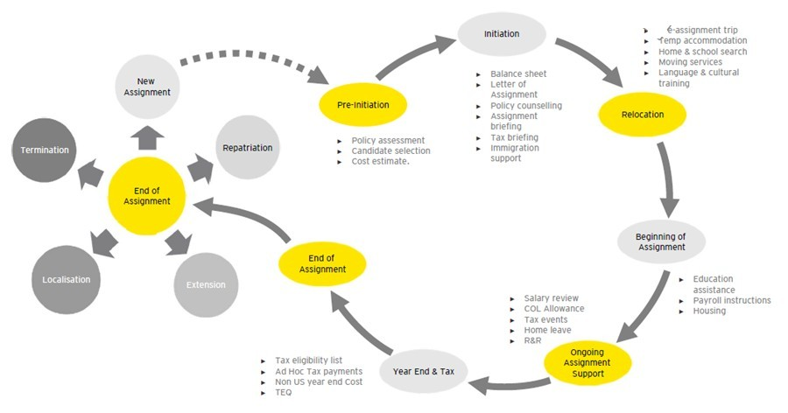
Payroll process –
The mobility lifecycle
Illustrative

Slide 6
Payroll best practices –
Sample decision guide
Illustrative
Move Type?
Relocation
Secondment
Policy Type?
Type 1
Type 2
Type 3
Host Country
Payroll
Home Country
Payroll
HQ or GEO
Payroll
Split
Payroll

Slide 7
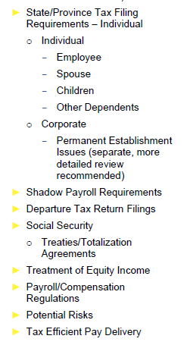
Payroll best practices –
Due diligence checklist
A due diligence checklist serves as a reminder of the policy and compliance considerations related to international moves
Promotes dialogue among program stakeholders (e.g., HR, Finance, Legal, Corporate Tax)
Promotes proactive planning and mitigates compliance risks
Particularly useful for planning entry into a new country or location
Considerations:
Which stakeholders are represented in the checklist?
Who is responsible for documenting decisions and outcomes?

Slide 8
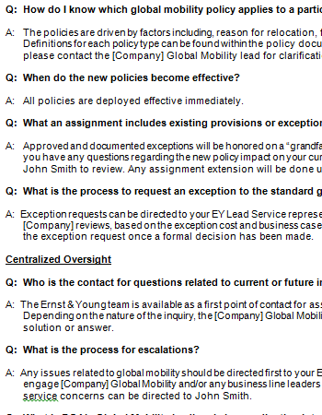
Payroll best practices –
Mobility FAQ document
Target audience may be international assignees and/or program stakeholders
Payroll FAQ document typically has a permanent role that accompanies the policy documentation
Additional FAQs accompany an announcement regarding change in the mobility program contacts, policy, or procedures
Considerations:
Who is tasked with updating regularly?
What is the most effective means of distribution (e.g, e-mail, intranet site)?
Does each policy have it’s own FAQ for payroll or can payroll considerations be covered with one?

Slide 9
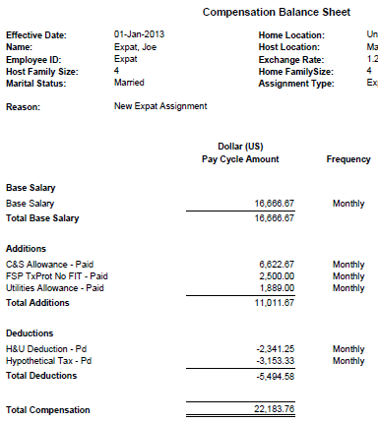
Payroll best practices –
Assignee balance sheet
Used to calculate and communicate assignment-related allowances and deductions
Delivered to the assignee prior to the assignment, and at the time of any subsequent changes
Delivered to payroll if no automated systems interface exists
Considerations:
Where is assignment related income delivered (home / host / HQ / split)?
What is the appropriate currency and pay frequency for the calculations?
How do the line items map to payroll wage types?
Are gross-ups calculated automatically in the payroll system, or do they need to be instructed on the balance sheet?

Slide 10
Expatriate taxation

Slide 11
Taxing expats –
Who is an expatriate?
The individual is a US citizen or a green card holder
AND
Who has a foreign tax home
Tax home:
  Main place of business, employment, or post of duty
  Place where taxpayer is permanently or indefinitely engaged to work as an employee or self-employed individual

Slide 12
Taxing expats –
Implications of international assignments
  Inflated wages – who will pay the related tax?
  Double taxation – both in the home and host countries
  Complexity with payroll and tax filing obligations in the home and host country

Slide 13
Taxing expats –
Foreign earned income exclusion
For 2015, the maximum exclusion is $100,800 per taxpayer. In addition, the taxpayer may exclude housing expenses in excess of 16% of this maximum with limits
Foreign earned income is income you receive for services you perform in a foreign country during a period your tax home is in a foreign country
Place of payment is immaterial

Slide 14
Taxing expats –
Bona Fide Resident (BFR) test
Individual must be a US citizen and establish residency in a foreign country for an uninterrupted period that includes an entire US tax year
AND
Individual must have a foreign tax home
For example, if taxpayer goes overseas on assignment in mid 2016, to qualify for the exclusions in 2016, he must have a tax home in a foreign country and be resident overseas for the entire tax year 2017

Slide 15
Taxing expats –
Physical Presence Test (PPT)
Used by US citizens and resident aliens
Tax home in a foreign country
Taxpayer physically present in a foreign country or countries for full 330 days during any consecutive 12 month period
  330 days does not have to be consecutive
  Full day of foreign presence is a 24 hour period beginning at midnight

Slide 16
Taxing expats –
Foreign tax credit
What are foreign tax credits?
  Income taxes that are paid or accrued to a foreign country on foreign source income. The same income must also be subject to US income tax
  By taking a deduction or credit, the foreign taxes reduce the US tax liability, and therefore, relieves taxpayers from a double tax burden

Slide 17
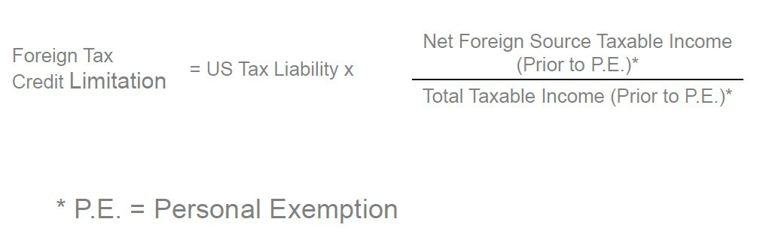
Taxing expats –
Limitation of foreign tax credit
The foreign tax credit is limited to the lesser of the foreign taxes paid or accrued in the year, or the foreign tax credit limitation. If foreign tax is higher than US tax on same income, credit is limited to US tax

Slide 18
Taxing expats –
Payroll considerations
The worldwide wages paid by a US employer to US employees who are US citizens and residents are generally subject to federal income tax withholding and the wages are required to be reported on W-2s.
An exemption from federal income tax withholding applies:
  If the employee completes, signs and returns Form 673 to the employer provided the employee qualifies for the IRC §911 exclusion or;
  If the employee is a US citizen and his wages are subject to mandatory foreign tax withholding - IRC Code §3401(a)(8)(A)(ii) or;
  If the employee completes new W-4 based on his/her anticipated foreign tax credit

Slide 19
Taxing expats –
Payroll considerations (cont.)
FICA tax is due on wages of US citizens and permanent residents for services performed outside the US for an American employer or for a foreign affiliate with an IRC §3121(l) agreement in place
FUTA and SUTA tax is generally due on wages of US citizens (not permanent resident residents) for services performed outside the US for an American employer

Slide 20
Taxing expats –
Compliance challenges
Shadow payroll reporting in foreign jurisdiction
Capturing global wages for US wage reporting and withholding
Tracking and reporting multi-year compensation for US vs. foreign purposes (timing issues)
Tax reimbursement policies (e.g. tax equalization or tax protection)

Slide 21
Tax equalization
What is it?
  Fundamental concept – to hold an employee responsible for taxes as if he or she had “stayed at home”
  Employee will remain neutral from a tax perspective
  Removes taxes from the equation when an employee is making a decision about whether to take the foreign assignment
  The most common method for tax reimbursement

Slide 22
Understanding Tax equalization
Focus not on actual taxes but on stay-at-home tax (hypothetical tax)
Companies typically pays all actual (home and host) taxes in additional to other assignment allowances
Employee pays a stay-at-home tax (hypothetical tax) to the company. hypothetical tax gets withheld throughout the year as if he or she had stayed at home (similar to US federal tax withholding or pay-as-you-earn)
A final reconciliation is prepared to settle the overpayment/underpayment of hypo tax withholdings at year end once the actual returns are finalized.

Slide 23
Foreign nationals

Slide 24

Taxing foreign nationals –
Who are they?
Definition: individual who are not US citizens
Resident foreign nationals are taxed entirely differently from nonresident foreign nationals
US payroll withholdings requirements often do NOT match tax compliance requirements
  Tax based upon workdays
  Tax treaty positions
  Treas. Reg. §31.3401(a)(8)(A)-1(b)

Slide 25
Taxing foreign nationals –
Who are they?
Foreign nationals can file one of three types of returns in the US:
  Full year resident
  Full year nonresident
  Dual status (resident AND nonresident)
Who is a nonresident?
  Individual who is not
    A US citizen
    A lawful permanent resident (a green card holder)
    An individual who meets the Substantial Presence Test

Slide 26
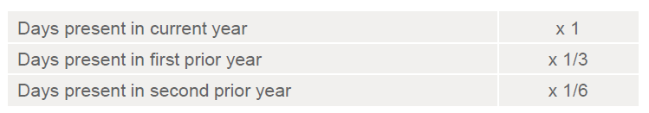
Taxing foreign nationals –
Substantial Presence Test (SPT)
Under SPT, an individual is generally considered a resident:
  During any year in which (s)he is present in the US for 183 days or more.
  If upon ‘looking back’ to the two prior years, the individual aggregates 183 days or more using the following formula
  It is important to remember that under SPT, any portion of a day in the US counts as a US day. Thus if a plane lands in the US at 11:59pm, the entire day counts as a US day under SPT.

Slide 27
Taxing foreign nationals –
Common exceptions to SPT
Commuters from Canada and Mexico
  If an individual regularly commutes to the US for employment from their residence in either Canada or Mexico, such an individual shall not be treated as physically present in the US on any day during which they commute
Closer connection exception 7701(b)-2
There are four types of exempt individuals:
  Teacher/trainee and students on F, G, J, M and Q Visas
  Diplomatic status/foreign government employees
  International organization employees
  Professional athletes

Slide 28
Taxing foreign nationals –
What is a tax treaty?
Purpose:
  Eliminate double taxation
  Residency
  Reduced tax rates
  Sourcing and exemption of income
  Prevent fiscal evasion
Background:
  First US tax treaty was in 1932 with France
  US has treaties with more than 60 countries

Slide 29
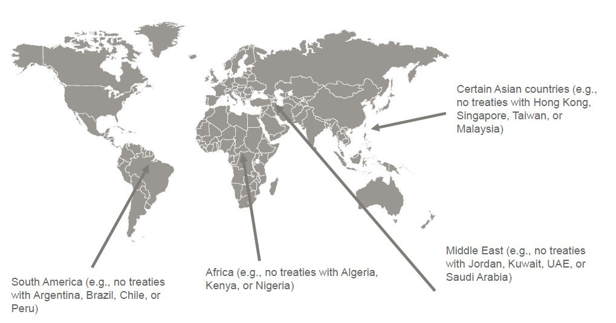
Taxing foreign nationals –
US income tax treaty network “holes”

Slide 30
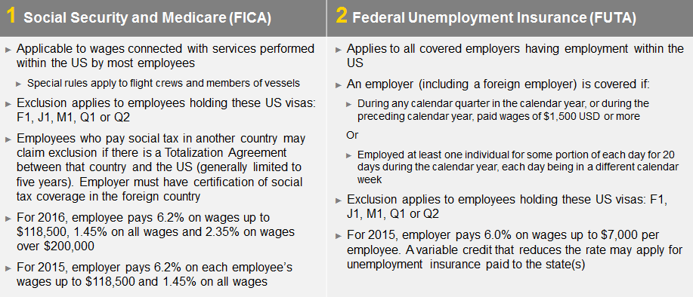
Taxing foreign nationals –
Payroll considerations

Slide 31
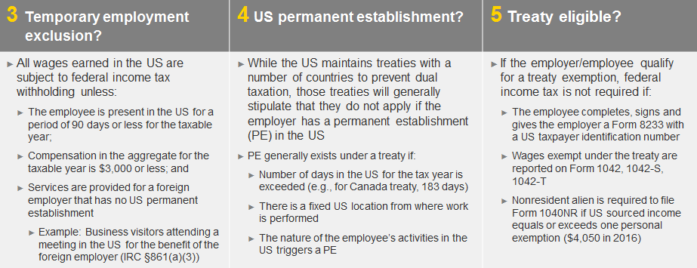
Taxing foreign nationals –
Payroll considerations (cont.)

Slide 32
Social Security totalization agreements
Social Security totalization agreements eliminate dual social tax when a worker is required to pay such tax on the same earnings in more than one country.
These agreements also fill gaps in benefit protection when workers have divided their careers between the US and another country.
The exemption under a Totalization Agreement applies for a limited period, generally, five years.
Employees must present a certificate of coverage from the foreign country to qualify for exemption from US Social Security and Medicare tax under the agreement.
Countries with Social Security totalization agreements with the US
Australia | France | Poland
Austria | Germany | Portugal
Belgium | Greece | Slovak Republic ^{New in 2014}
Brazil (in process) | Ireland | South Korea
Canada | Italy | Spain
Chile | Japan | Sweden
Czech Republic | Luxembourg | Switzerland
Denmark | Netherlands | United Kingdom
Finland | Norway

Slide 33

Questions?

Slide 34
Thank you

Slide 35
EY | Assurance | Tax | Transactions | Advisory
^{About EY}
EY is a global leader in assurance, tax, transaction and advisory services. The insights and quality services we deliver help build trust and confidence in the capital markets and in economies the world over. We develop outstanding leaders who team to deliver on our promises to all of our stakeholders. In so doing, we play a critical role in building a better working world for our people, for our clients and for our communities.
EY refers to the global organization, and may refer to one or more, of the member firms of Ernst & Young Global Limited, each of which is a separate legal entity. Ernst & Young Global Limited, a UK company limited by guarantee, does not provide services to clients. For more information about our organization, please visit ey.com.
Ernst & Young LLP is a client-serving member firm of Ernst & Young Global Limited operating in the US.
^{© 2016 Ernst & Young LLP.}
^{All Rights Reserved.}
^{BSC No. 1607-1986902}
^{ey.com}

